Slide 1
Image Classification through Convolutional Neural Network & ResNet
Data Set: Extended MNIST Dataset
Python, Tensorflow, Keras

Slide 2
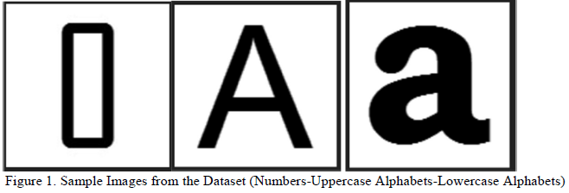
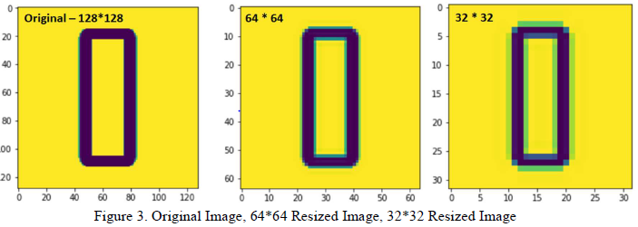
Abstract
This study is aimed to develop a deep learning model to classify images and obtain maximum accuracy and minimum runtime. The data used for this study consists of 2 sets - one is the training set and another is the validation set. The training set consists of 37882 images of 128 * 128 pixels. The validation set consists of 6162 images of 128 * 128 pixels. The classification task has been designed and implemented using deep Convolutional Neural Network (CNN) and ResNet algorithms along with tuning the hyper-parameters.
Data Exploration & Pre processing
There are 10 digits (0 to 9 - 10 classes), upper case alphabets (A to Z – 26 classes) and lower-case alphabets (a to z - 26 classes) with a total of 62 unique classes to predict.

Slide 3
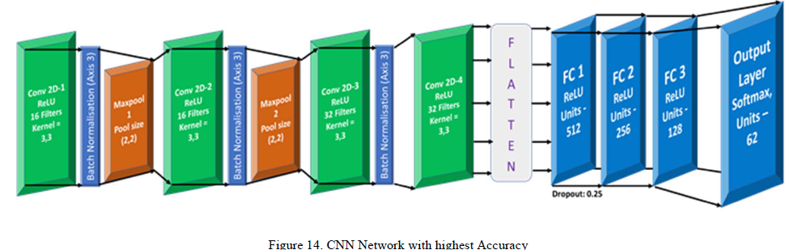
Model 1 - CNN
Following CNN model was found to provide highest accuracy amongst all the CNN models tested.
Accuracy of the model in Validation dataset: 90.73%

Slide 4
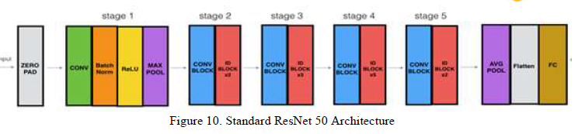
Model 2 - ResNet
The common ResNet 50 model was designed which includes 50 layers. Resnet uses residual blocks which use residual connections. These connections create an identity function which lets the input to the residual block reach the next block without affecting its value.
Typical ResNet implementation consists of 2 types of residual blocks:
Identity shortcut block
Projection shortcut block
The Final accuracy produced by the ResNet 50 for 50 epochs is 89.5%

Slide 5
Conclusion
The aim of this experiment has been satisfied by executing a CNN and ResNet model for image classification. This study has also provided wide opportunity to explore the hyper parameter optimisation of CNN and ResNet algorithms. Based on the experiment, it is concluded that
Convolutional Neural Network performs better than the ResNet algorithm by achieving an accuracy of 90.73% on the validation dataset

